Slide 1

Visual Analytics of Shark Attacks in Australia
Group 20
Gnanesh Parnam - 02130534
Hitesh Kashyap Varma Lakkamraju - 02129088
Harsha Vardhan Varma Mantena - 02129359

Slide 2
Why and How
Why | How
Geographic Distribution: Visualize the spread of shark incidents across Australia to identify high-density areas by year. | A map chart show where the shark incidents happened in Australia filtered by the shark types and the ability to zoom the geographical map.
2. Year and State Trends: Showcase trends in shark incidents over time, categorized by state, to analyze patterns and variations. | A stacked bar chart representing the comparison of the incidents across the states for each year filtered by states, number of attacks and also a toggle for the filteration through years
3. Incident Locations: Locate and highlight specific shark incident sites on a geographic map to understand spatial patterns. | A scatter plot presenting the exact locations on the map filtered using the brushing and selection technique and toggling by the states.
4. Shark Species Analysis: Identify the most frequently involved shark species in incidents using dynamic visualizations | A bar chart race that shows which shark species were involved over time.

Slide 3
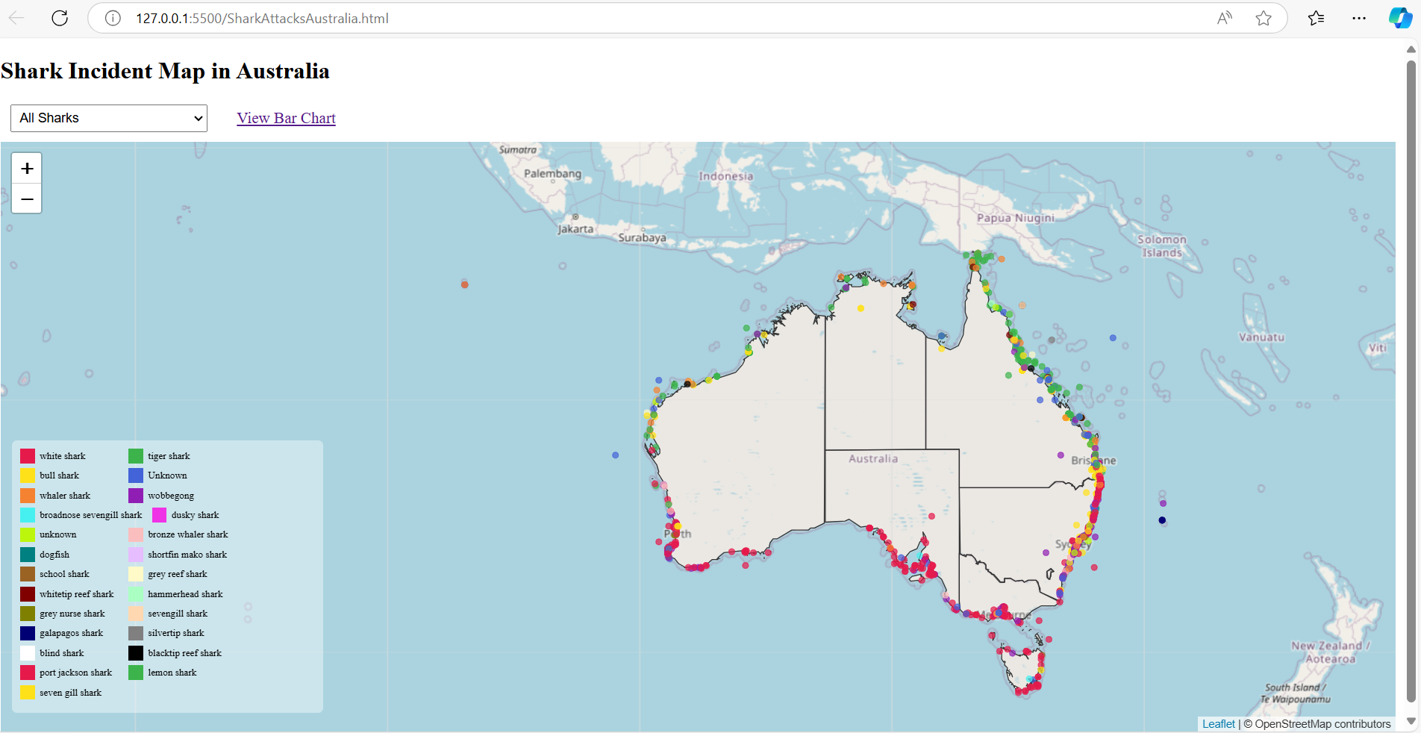
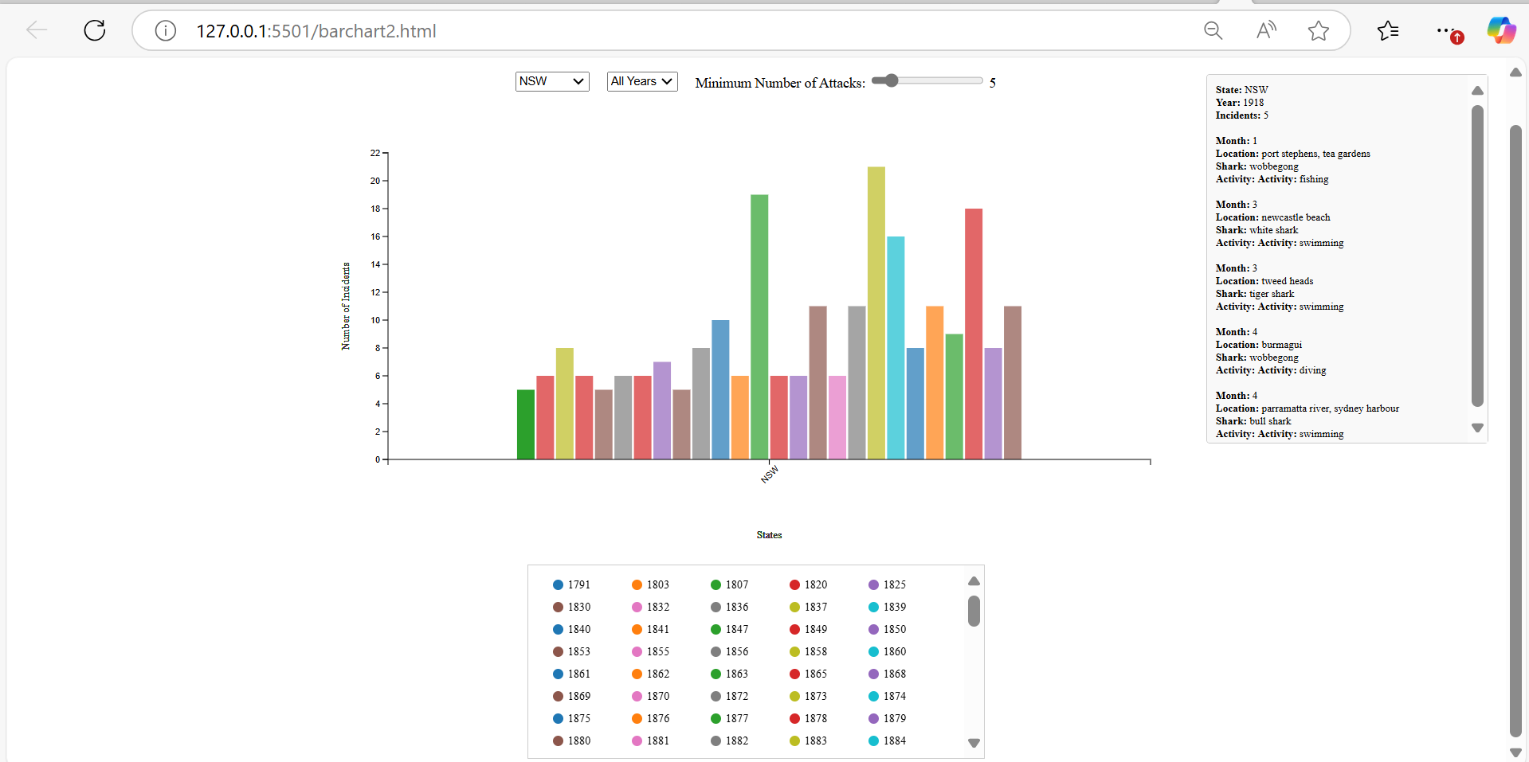
Design
Figure 1 : Geographic Map
Caption: : Shark incidents mapped across Australian states with filtering by shark types.
X-Axis and Y-Axis: The geographic coordinates (latitude and longitude) to plot shark incidents accurately on the map.
Marks: Colored markers on the map, each representing an individual shark incident.
Encodings:
Color: Represents the state where the shark incident occurred.
Tooltip: Displays additional information about each incident, such as location and shark type, on hover.
Figure 2 : Stacked Bar Chart:
Caption: Yearly trends of shark incidents, categorized by state.
X-Axis: States in Australia, showing incidents categorized by state.
Y-Axis: Number of shark incidents over time.
Marks: Stacked bars, where each segment represents incidents for a particular year.
Encodings:
Color: Differentiates the years, making it easier to identify trends over time.
Size (Height): Indicates the count of incidents for each state and year.

Slide 4
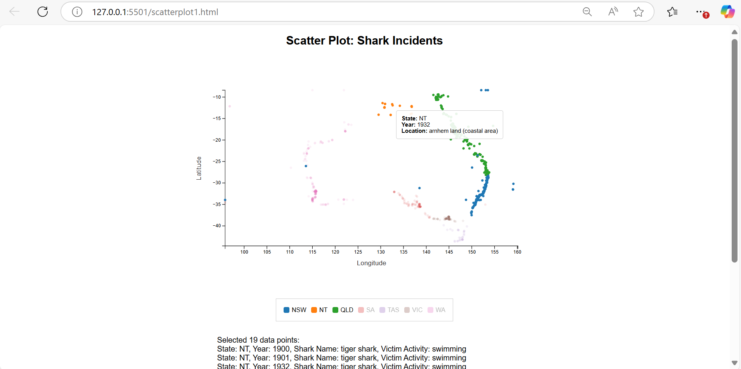
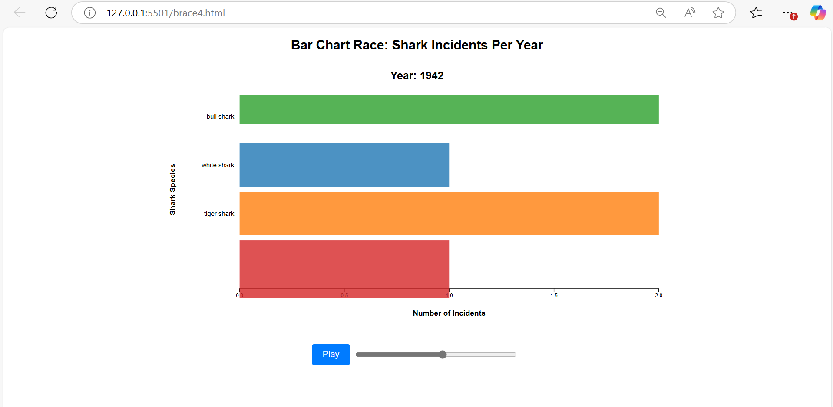
Design
Figure 3 : Scatter Plot
Caption: : Locations of shark incidents, highlighting high-density areas using brushing and selection
X-Axis: Longitude, representing the horizontal geographical location of shark incidents.
Y-Axis: Latitude, representing the vertical geographical location of shark incidents.
Marks: Dots or circles, each representing a specific shark incident
.
Encodings:
Color: Represents the state of the incident.
Tooltip: Displays detailed information about the incident, such as the year, location, and activity.
Figure 4 : Barchart Race
Caption: : Locations of shark incidents, highlighting high-density areas using brushing and selection
X-Axis: Count of shark incidents for each species over the years.
Y-Axis: Shark species, ranked dynamically as the chart progresses over time.
Marks: Horizontal bars, representing the number of incidents involving each shark species.
.
Encodings:
Color: Differentiates the species for better readability.
Animation: Displays changes in the number of incidents dynamically over time, providing a visual narrative.

Slide 5
Discussion
Geographic Map
Created an interactive map of Australia using Leaflet.js and D3.js, with color-coded markers, a legend, and dropdown filters for shark types. Added tooltips for detailed information, validated incident data, and linked the map to the Bar Chart visualization.
Stacked Bar Chart
Developed a grouped bar chart showing shark incidents by year and state with dropdowns, a range slider, and a legend for filtering. Enabled tooltips for detailed incident information and dynamically updated scales for seamless interactivity.
Scatter Plot
Designed a scatter plot to visualize shark incidents by location, with brushing and a legend to filter states interactively. Implemented tooltips for detailed data points and toggleable visibility for states via the legend.
A Bar chart Race:
Created an animated bar chart race to showcase shark incidents by species over years, with play/pause controls and a time slider. Dynamically updated axes and colors for clear visual representation and smooth transitions.

Slide 6
Obstacles
Limitations:
For Bar chart Dropdown-based filtering may not be intuitive for users with complex data needs.
The visualization does not display details for points with invalid or missing coordinates (NaN latitude/longitude), which could slightly skew insights. However, this issue is minimal and does not significantly affect overall analysis.
Overlapping points can obscure data in dense regions, making it harder to analyze. Time slider controls can be less intuitive during fast-paced animations
Improvements:
Improve user interactivity by adding a navigation menu for seamless traversal between visualizations and implementing shared filters across pages for a unified experience.
GitHub Link
https://gnaneshparnam.github.io/Project_Phase3_Group20/

